Slide 1



TANZANIA WATER WELLS PREDICTIVE ANALYSIS
TROY STEVE

Slide 2
Business Problem
DEVELOP A CLASSIFIER TO HELP PREDICT THE STATUS OF WATER WELL PUMPS.
Functional status
Functional but need repairs status
Non-functional status

Slide 3

DATA
The data at our disposal comes from Taarifa and the Tanzanian Ministry of Water.
The target (status_group) has three categories making this a ternary classification problem by default.

Slide 4

MODEL DEVELOPMENT
DATA CLEANING
EDA
MODELING
SIMPLE MODELS
TUNED AND COMPLEX MODELS
MODEL SELECTION
INTERPRETATION

Slide 5
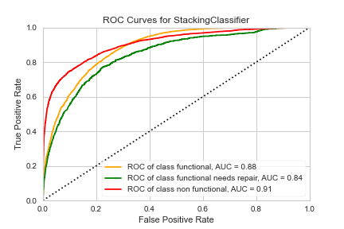
MODEL SELECTION
THE BEST CLASSIFIER WAS SELECTED BY CHOOSING THE ONE THAT HAD THE HIGHEST F1 SCORE

Slide 6
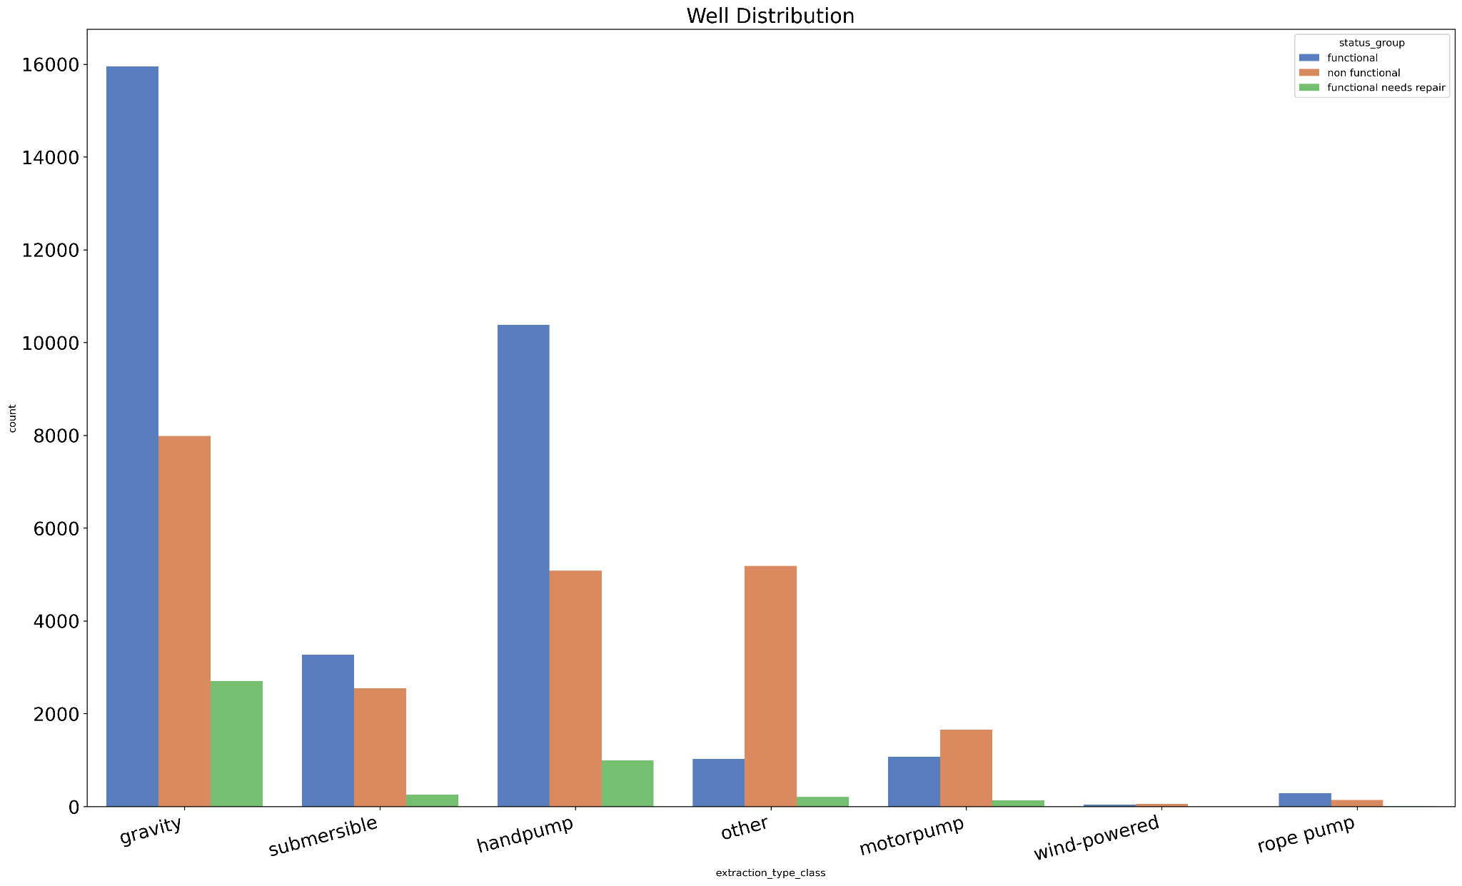
Relationship of well pump status and the mode of extraction
Motorpump mode should be done away with as it seems to have more non functional pumps than functional

Slide 7
FINAL MODEL
The final model has the following scores
accuracy: 0.783
precision: 0.777
recall: 0.783
f1: 0.771

Slide 8
Conclusion
The model we've come up with has an accuracy score of 78% meaning that the Tanzanian government will be able to predict correctly 78% of the times it wants to pump funds towards replacement of pumps that aren't functional and towards repairing of those that are functional but need repairs.
This will save the government the time and resources it would have used to go round checking the pumps and at times investing in those wells that it shouldn't.

Slide 9
Recommendations A
The model that has been developed and the analysis that was done will go a long way in helping the Tanzanian government to make the necessary interventions in order to address the issue of water shortage in the country.
The government should study keenly gravity as the mode of extraction of water in the wells. This is because this mode has the highest number of non functional wells. However this mode has a high number of functional pumps. As a mode, of keen interest is motorpump. The number of non functional pumps outnumbers that of functional pumps. It's recommended that the government should stop using this mode of extraction.

Slide 10
Recommendations B
VWC manages many wells in Tanzania. VWC also has the highest number of non functional pumps. The government should investigate why this is so. Is it because VWC is overwhelmed by the number of wells it is managing or it because it's not getting enough funds to help maintain these wells.
The government should also consider drilling more wells as majority of the wells do not have sufficient water quantity. Most wells have either insufficient, dry, seasonal and unknown.
The government should also send experts to Mbeya, Morogoro and Shinyanga so that they can look into at the pumps in these areas as they have a high number of non functional pumps. Regular visits to this areas by officials should be done.

